Slide 1

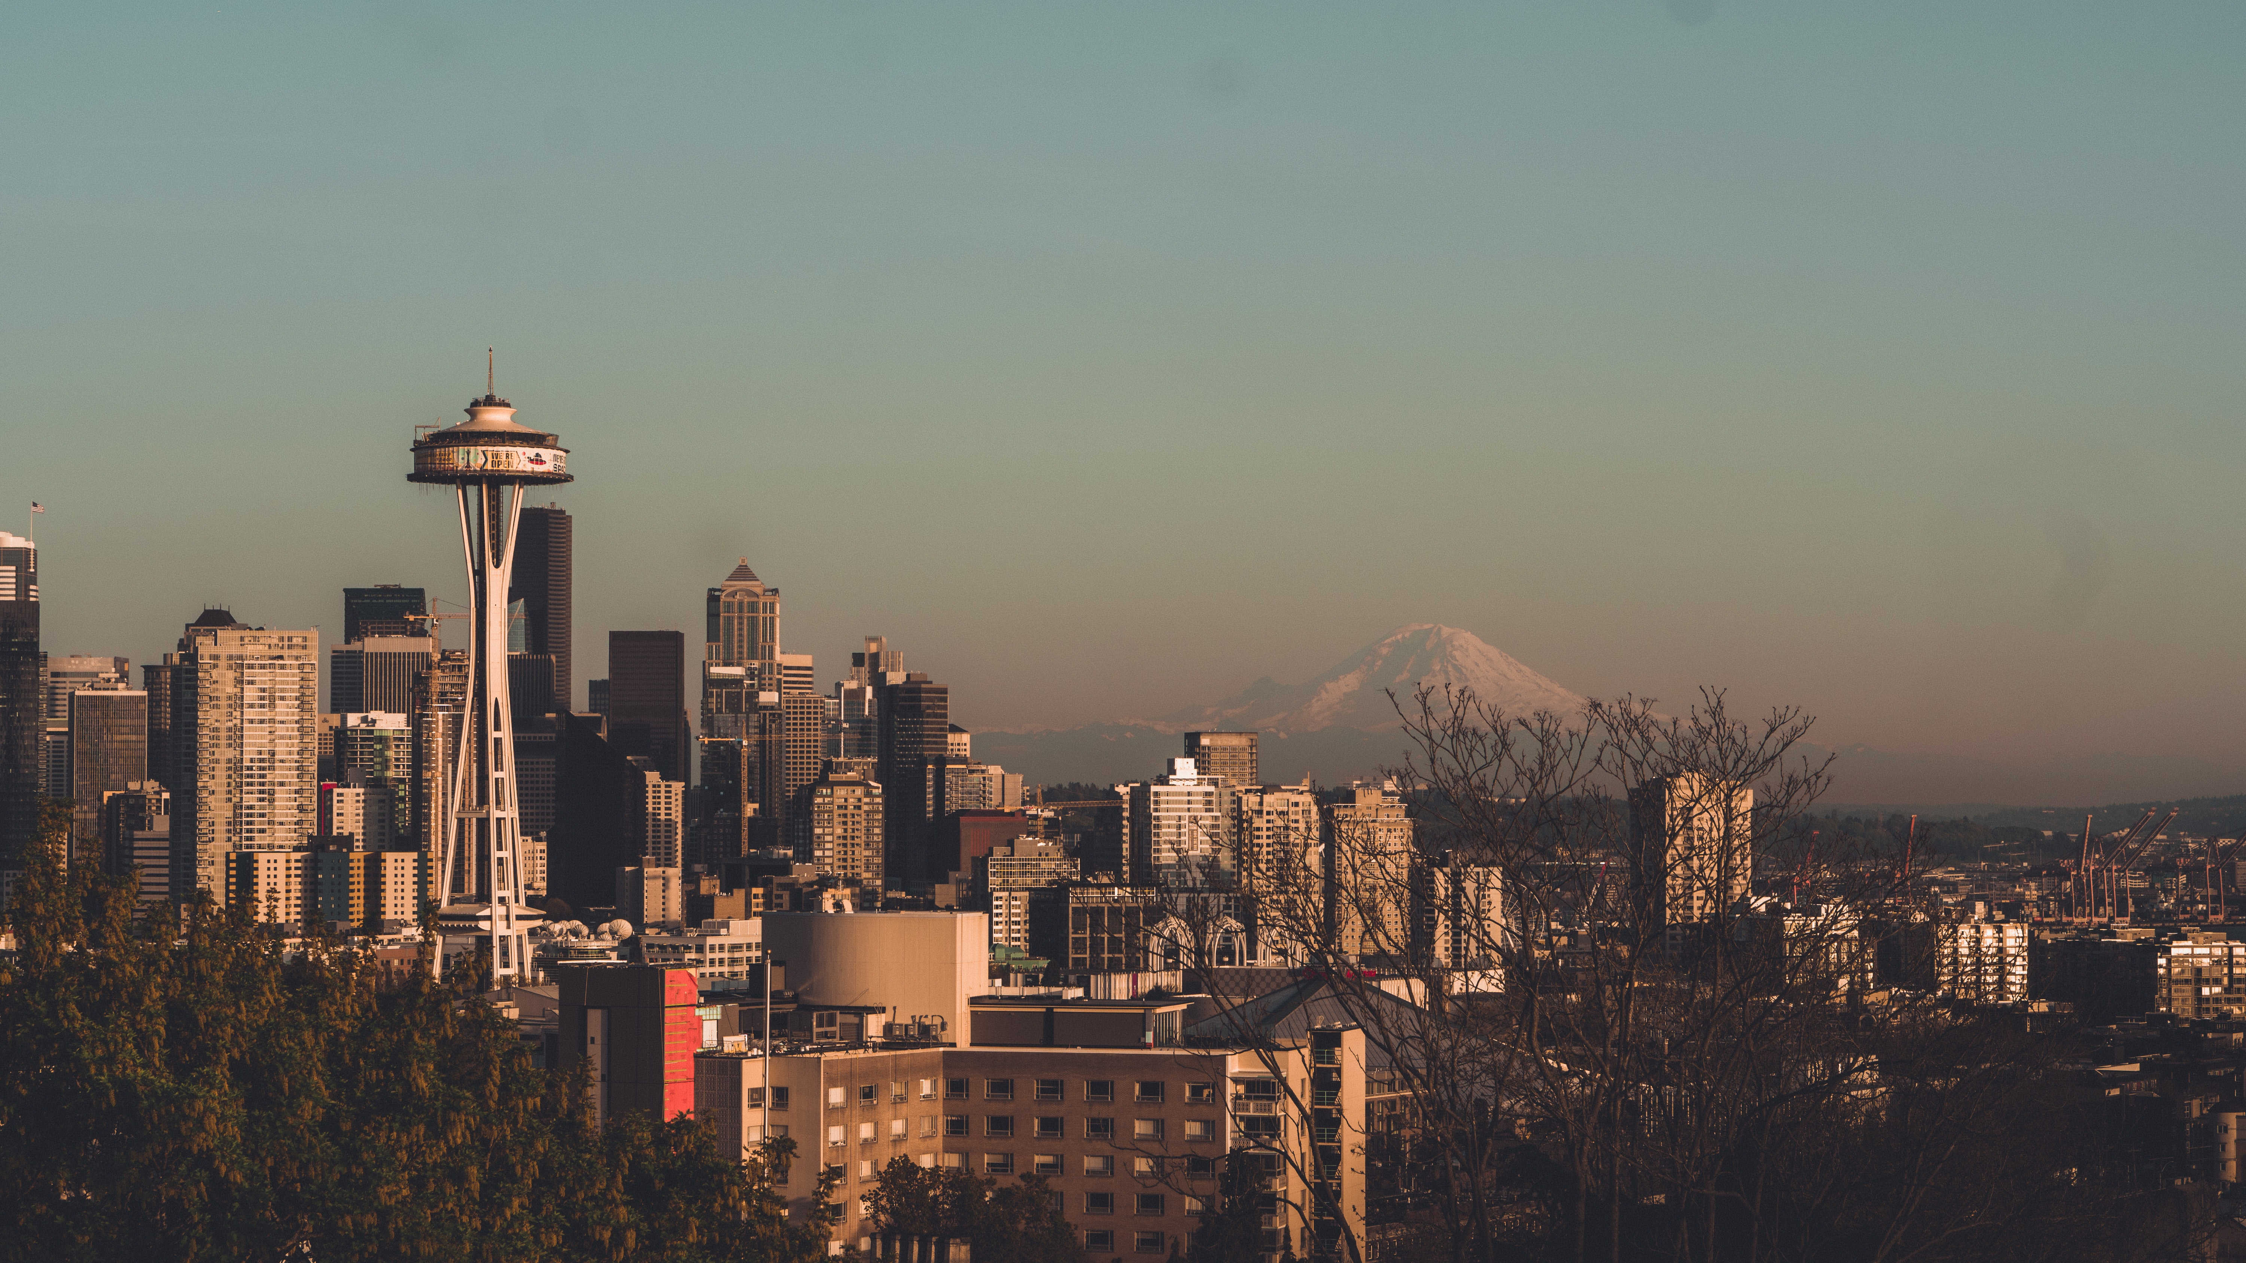

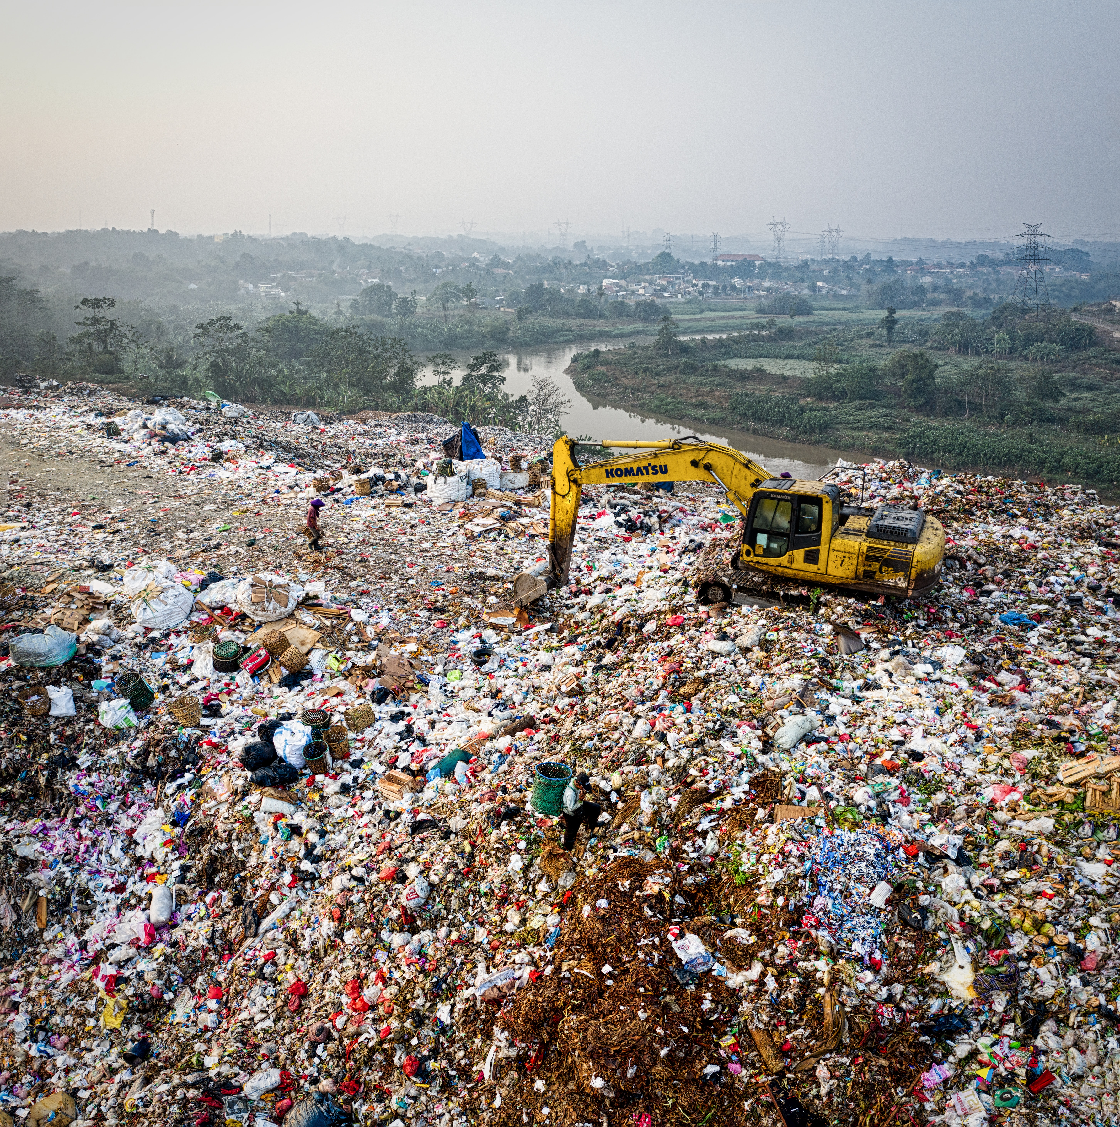

Where Does Your Trash Go?
A Washington State Waste Generation Analysis​
Group 1: ​
Anjali Sebastian
Yong Long Tan
Vincent Marklynn
Zachary Jeffreys

Slide 2

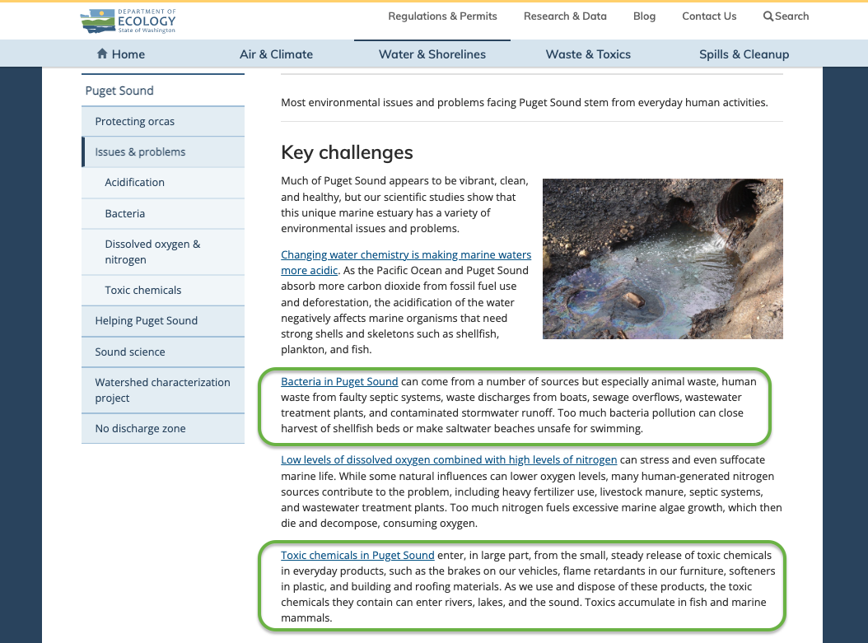

Motivation
Solid Waste is Constantly Generated. (Municipal Solid Waste)
We want to investigate and understand how solid waste is distributed in Washington state.
Visualize garbage production and movement to landfills.
The ecology.wa.gov is warning citizens of Washington State that we are poisoning our own eco-system with our waste making our Puget Sound TOXIC, ACIDIC & BACTERIA INFESTED ...

Slide 3

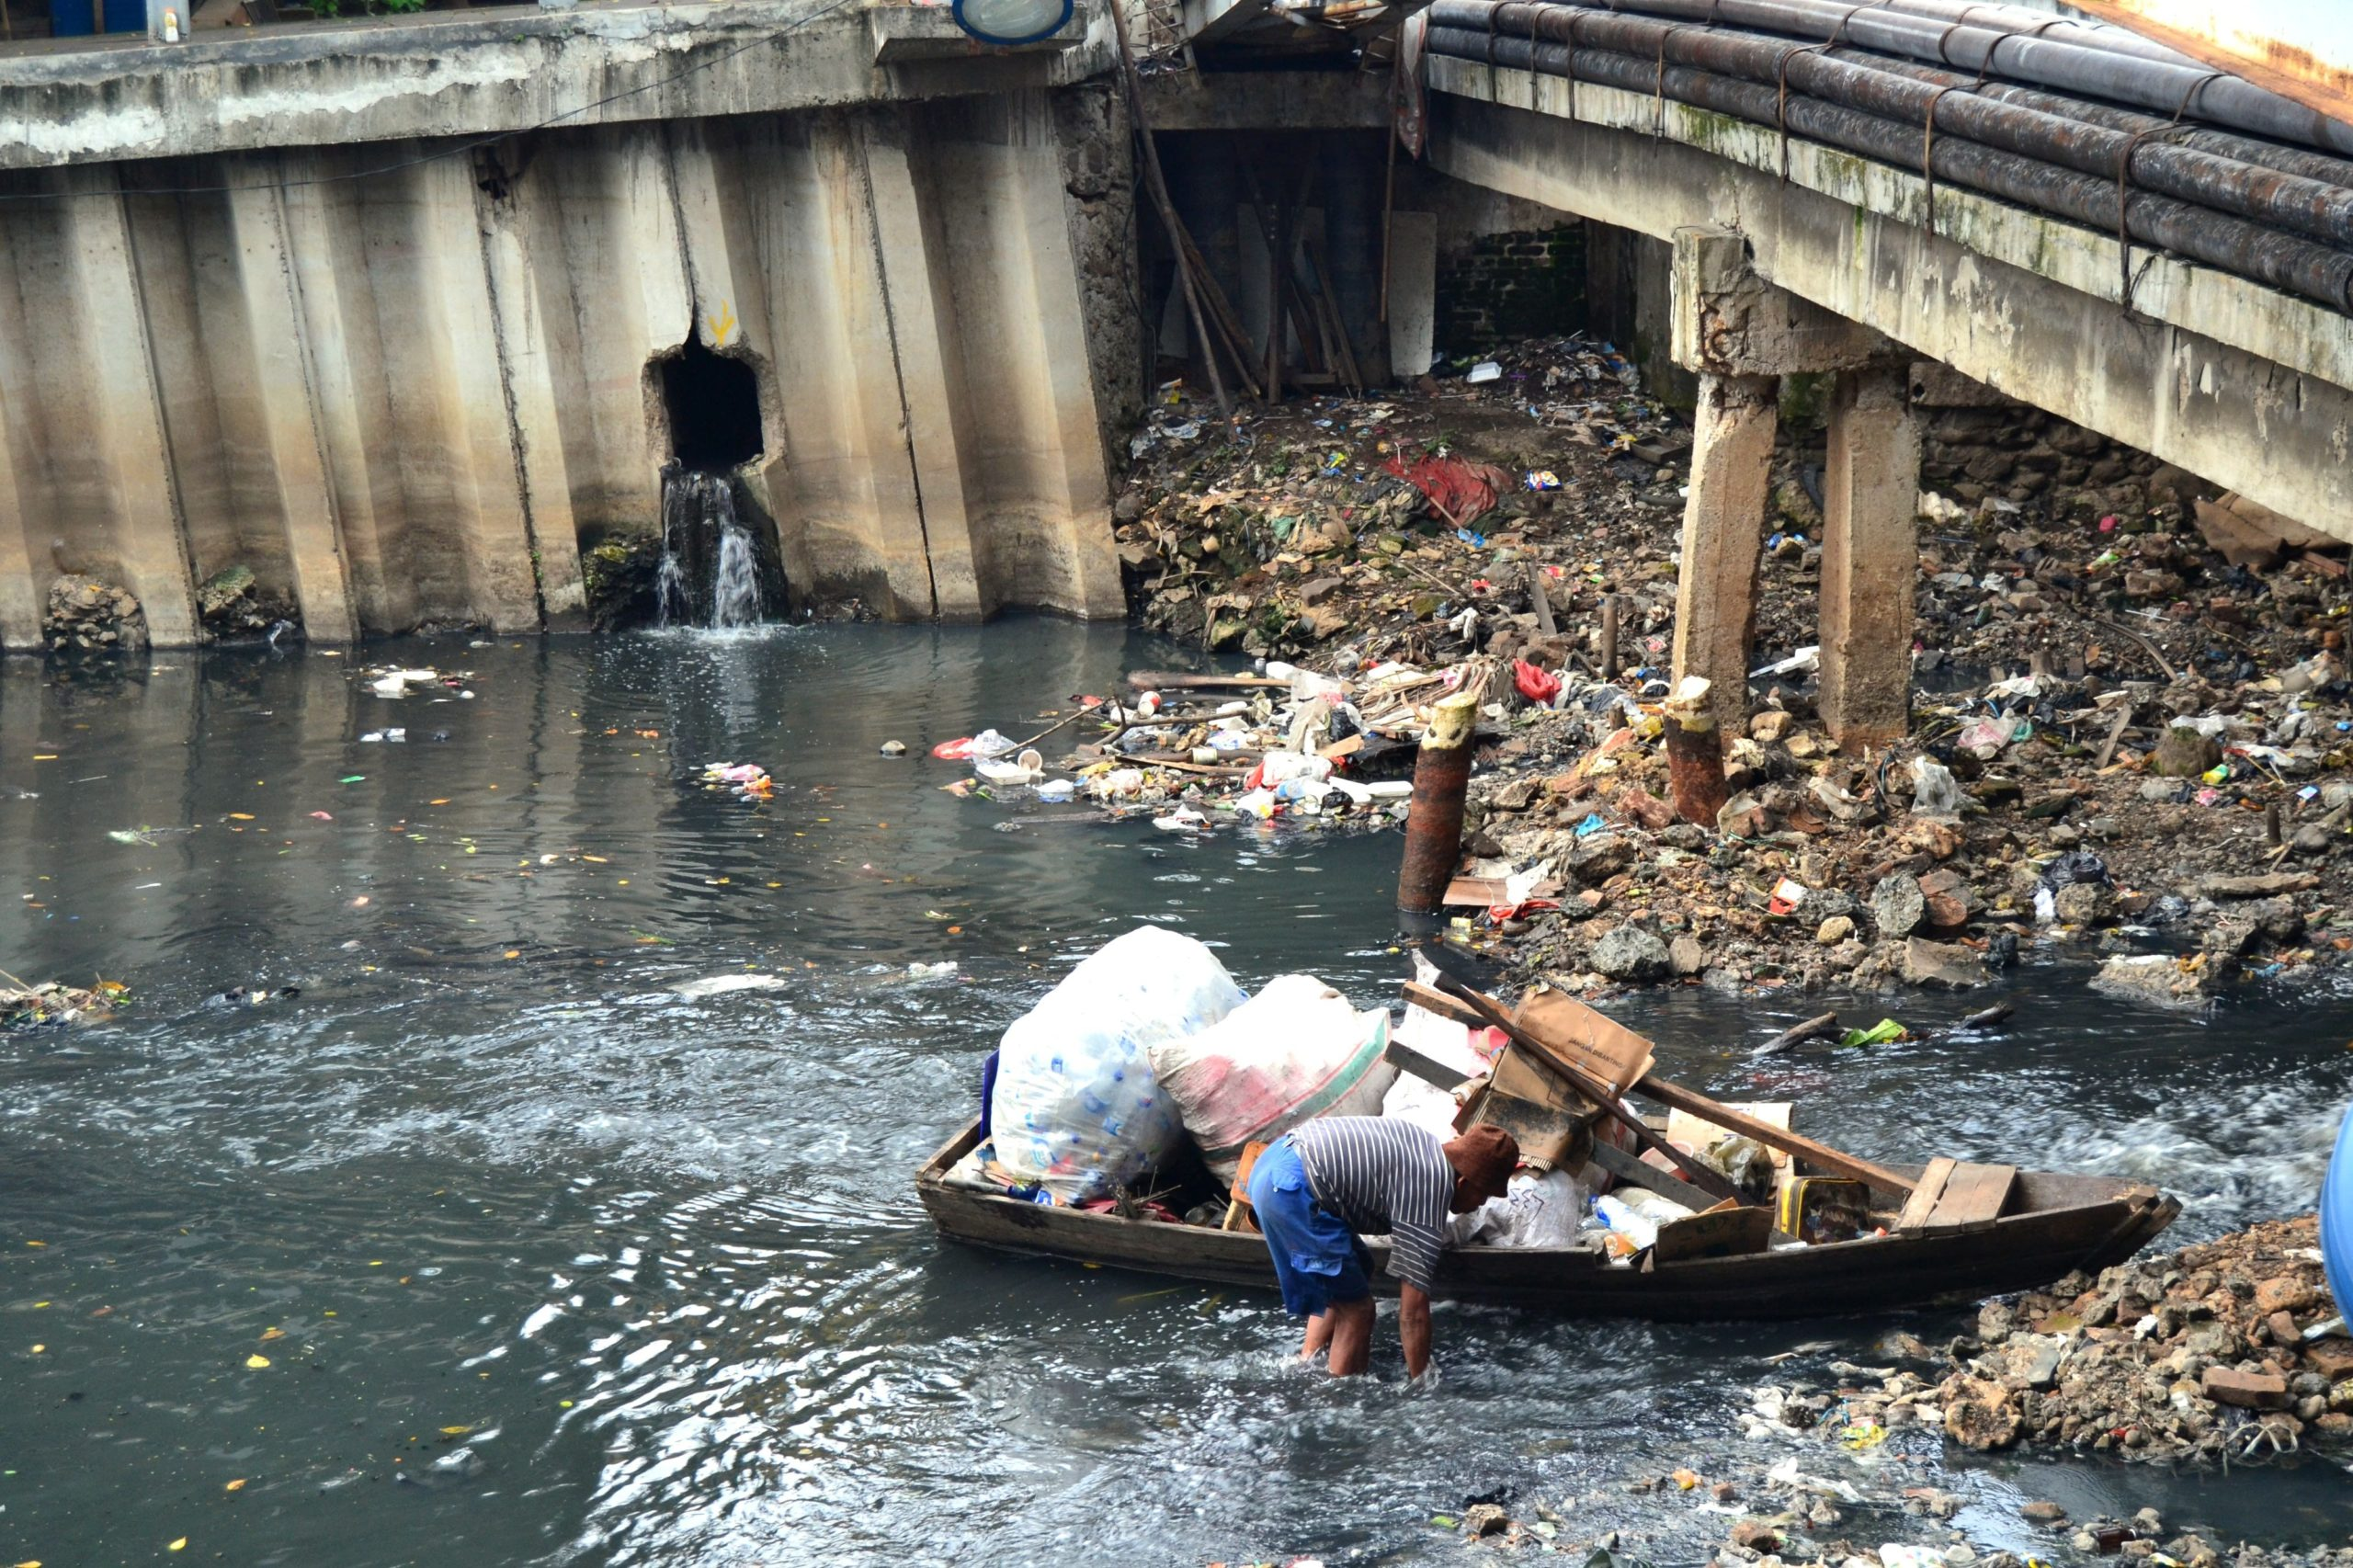
Audience All Washington State Residents
Our visualization is intended to encourage Washington Residents to be more aware of their waste generation and its impact on the environment
The ecology.wa.gov is warning citizens of Washington State that we are poisoning our own eco-system with our waste making our Puget Sound TOXIC, ACIDIC & BACTERIA INFESTED ...
This Photo by Unknown author is licensed under CC BY-NC.

Slide 4

Main Questions
Trends in Municipal Solid Waste by County in WA?
The most common waste generated by Counties in WA?
How much of waste is going to each landfill in Washington?
How much waste is recycled?
Municipal Solid Waste (MSW) generation and rate prediction
The impact of households if they produce less waste and recycle more?
Notes:
How much waste is recycled? 48% to 52%

Slide 5
Tools
Good Notes 5 for Designing
Pandas and Numpy
Excel
Tableau
PowerPoint
A Team Of 4 Exceptional MSCS Students

Slide 6
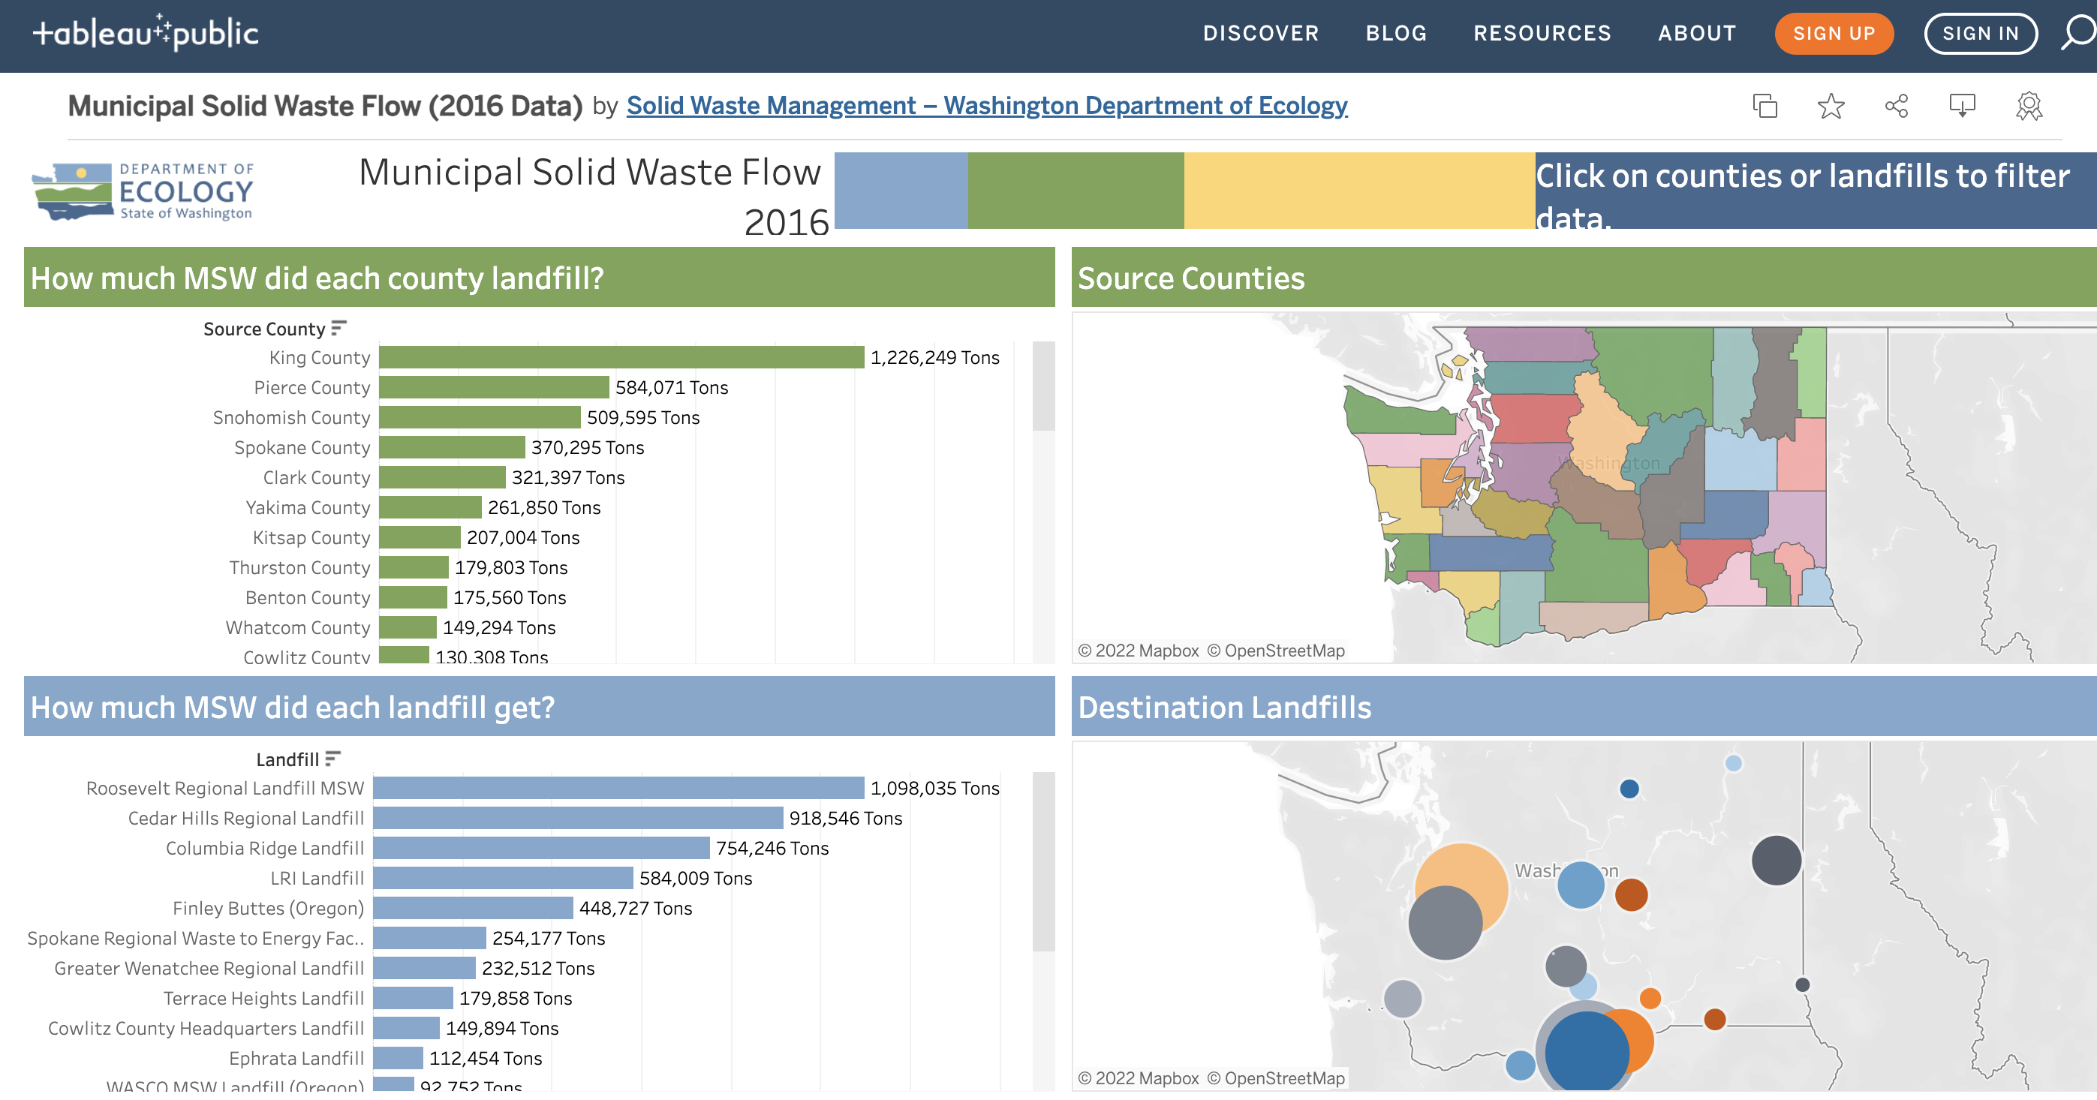
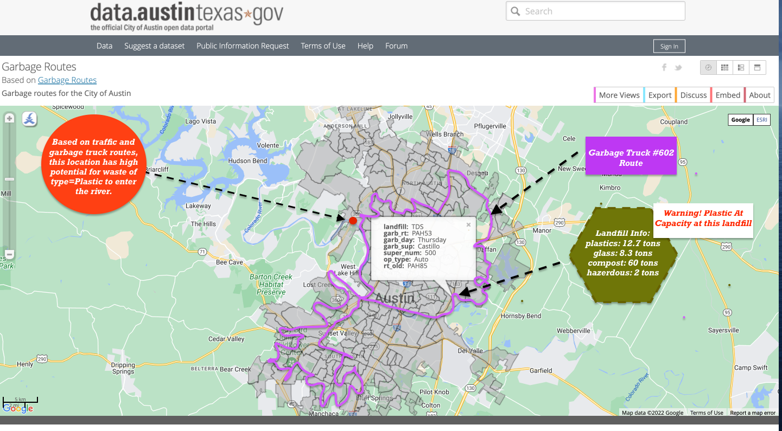
Related Work and Difference
Opportunity to use graduated colors.
More interactive. Uses map as the corner stone for exploration.
Different waste types, multiple years, future predictions.
A balance between too much detail and not enough.

Slide 7
DEMONSTRATION
LINK TO LIVE PAGE
LINK TO CSS

Slide 8
Design Rationale – 1/2
The map is cornerstone to explore information.
Clicking on the map triggers further information display.
A choropleth map that shows per capita waste.
A proportional map showing all the landfills in the WA.
Intuitive usage: e.g., clicking on county highlights landfills where the county’s waste goes to.
Intuitive Measures to describe the waste quantity created (Boeing 747 and Titanic as reference size)

Slide 9
Design Rationale – 2/2
Color scheme:
Avoided using red and green to de-mark predictions.
Waste grouping are colored using the color-blind color palette.
Avoiding too many pie slices: Treemap vs. Pie Chart
Clear predictions using Tableau’s in-built forecast module.
Interactively see the impact of waste reduction to motivate residents

Slide 10
Insights – 1/2
Washington sends waste to landfills in beautiful Oregon. Columbia Ridge and Roosevelt Landfills get the most waste.
King County is the highest contributor to waste in Washington
Cowlitz county has an unusually high per capita waste generation. Lots of construction waste and a low population.
County’s show different pattern when it comes to waste types
Highly urbanized counties like King generate a lot of “Construction Waste” and “Electronics and Appliance” .
Rural counties produce more “Paper ” or “Metals and Minerals”

Slide 11
Insights – 2/2
King County like majority of the counties in WA is showing an increasing trend of waste generation.
King County is the largest contributor to waste (39%) which equals 8798 Boeing 747 (= 450 tons) planes and 76 Titanic ships(= 52,310 tons).
There are some counties like Snohomish and Kittitas that are having a downward trend.
If we all reduce our waste generation by a modest value of 15% we can make a significant change.
A difference of around 700,000 tons annually and equals 1,534 Boeing 747 (= 450 tons) planes and 13 Titanic ships(= 52,310 tons).

Slide 12
Future Work & Questions
Use a connected map that dynamically changes with each years
Add more years from 2001 to 2013 and improve predictions
Questions ?

Slide 13
Information References
Data from: ecology.wa.gov
https://ecology.wa.gov/Water-Shorelines/Puget-Sound/Issues-problems
https://wsdot.wa.gov/construction-planning/protecting-environment/litter-state-highways#:~:text=The%20problem%20with%20litter,county%20roads%20during%20this%20time.

